Slide 1


Smart LPG Leakage Detector
To ensure ultimate safety.

Slide 2
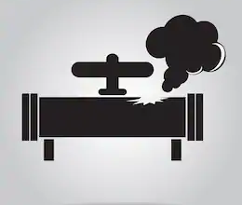
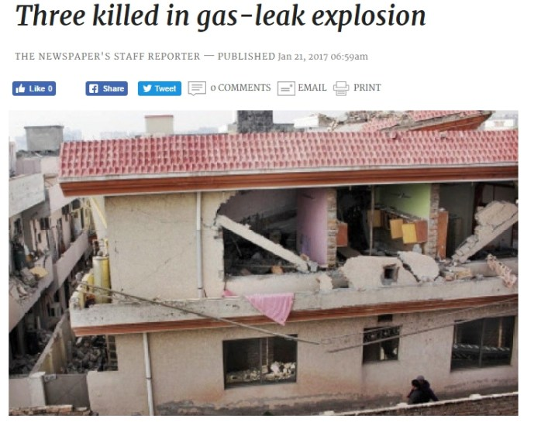
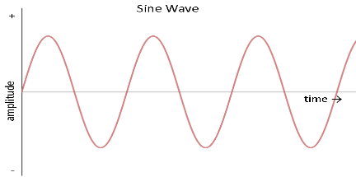
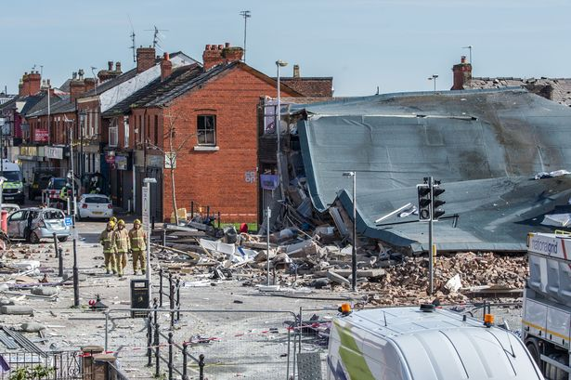
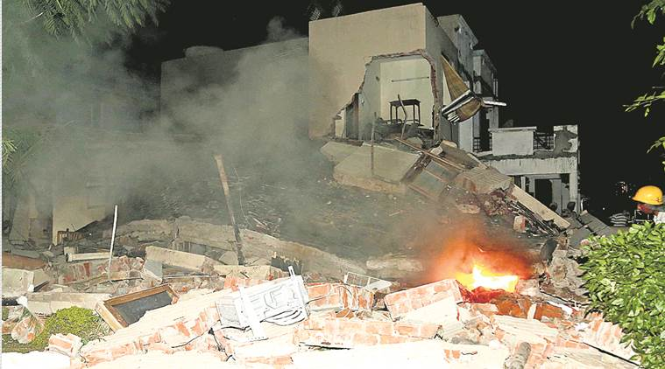
Problem :
Places like hotels, restaurants, kitchens, canteens, and some industries or factories which depend or use LPG, might put that place in risk of causing the fire accidents.
Exploding of cooking gas cylinders and stoves accounted 1/6th of all deaths.
Total 19,491 deaths accounted between 2010 and 2014 due to LPG leakage. (IndiaSpend)
Proposed Solution :
Turning of the main supply, when there is a gas leakage can avoid the fire accidents
Alerting the user and to fire station about the gas leakage and sharing the location of it would help to take necessary action, because there is no second chance.
Alerting the near by people through an alarm, can save life's.

Slide 3
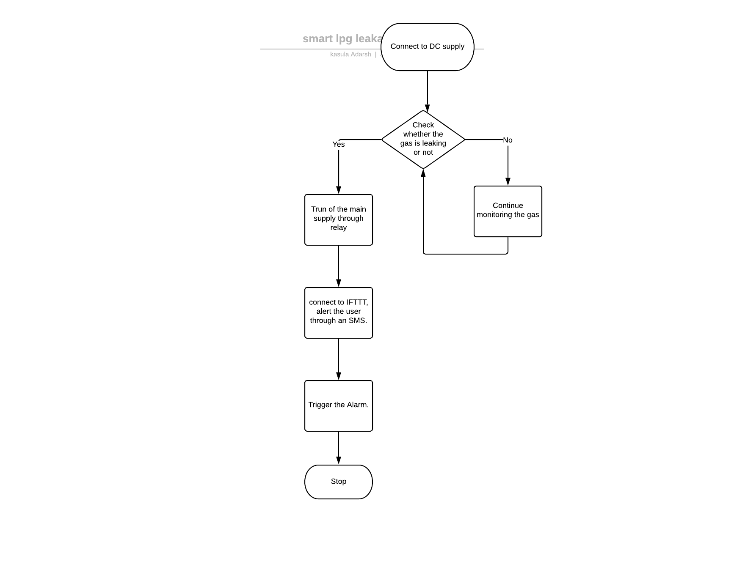
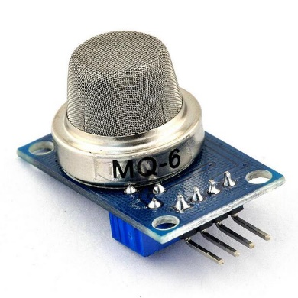
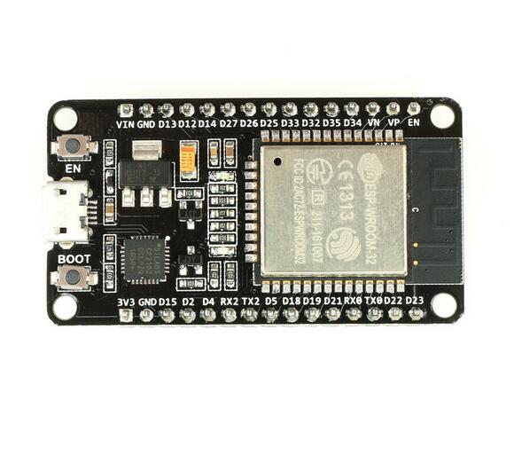
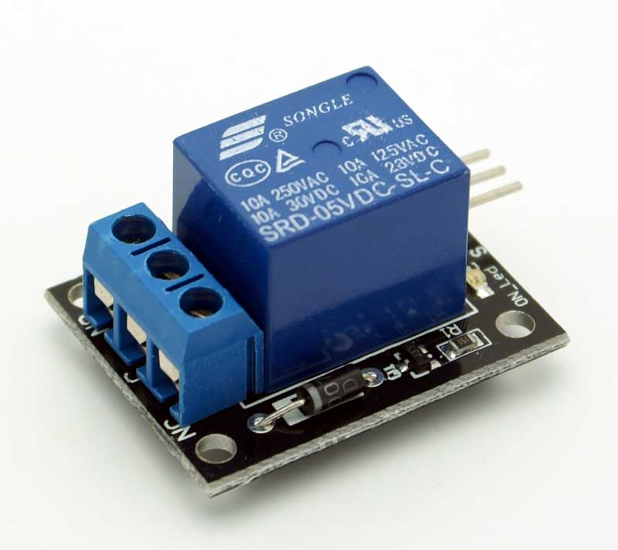

Slide 4
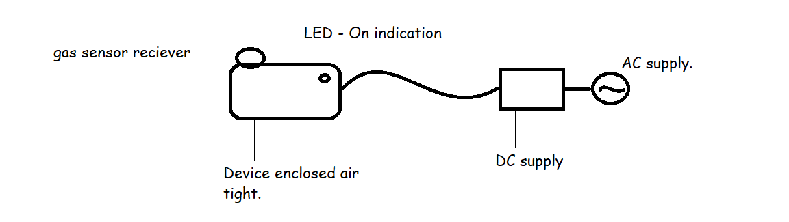
Smart LPG leakage detector.

Slide 5
Market :
Our customers are domestic and commercial users of LPG. This includes, hotels, restaurants, canteens, kitchens, factories or industries which depend on LPG.
According to our market research, about 80% people are using nothing to take such precautions.
Only High class and Higher middle class people are using ordinary LPG detectors.
https://www.surveymonkey.com/results/SM-JF77FL8ZV/
This product is mostly needed by factories which extensively use LPG and households who are afraid of fire explosions due LPG leakage.

Slide 6
Competition :
The ordinary LPG Detectors available in the market might be our customers.
They targeted the high class and higher middle class people who are concerned and afraid of LPG leakage.
Our product Smart LPG leakage detector is far better and different from ordinary LPG detectors.
Ordinary LPG leakage detectors just indicate or trigger an alarm when there is a gas leakage.

Slide 7
Marketing strategy :
Our customers are domestic and Commercial users of LPG.
We might interact with them directly or indirectly through LPG providers, making them aware of LPG leakage explosions and realize them how important our product is.
Showing our product working directly to the customers through marketing camps.

Slide 8
Revenue model :
Revenue sources – customers.
Price – Rs. 2000/-

Slide 9
Financials :
NodeMCU : Rs. 300/-
MQ6 sensor : Rs. 170/-
Relay : Rs.160/-
SMS sending service
Casing of device
Technology, machinery required for manufacturing the products.

Slide 10
TEAM:
K. Adarsh – Coding, Building, IoT, MATLAB
B. Srinath- coding, building, IoT, MATLAB
G. Vishnu – Market Research, MATLAB
G. Sohith – Market research , IoT, MATLAB
C. Pawan Reddy – Promotions, IoT, MATLAB
C. Srisailam – Promotions, IoT, MATLAB
- B. tech 4th year, EEE Department.

Slide 11
Q & A

Slide 12
THANK YOU!

